Slide 1
Health Development Corporation
Lisa Monteiro, Juliana Silva, Theresa Lechner
10 November 2018

Slide 2
Health Development Corporation
The Company Background

Slide 3
Health Development Corporation: The Company Background
General Information
CEO: Paul Couturier
Field: health and fitness clubs
Size: nine clubs and three other facilities with management contracts
Location: Greater Boston area
Style: leasing of clubs (usually)

Slide 4
Health Development Corporation: The Company Background
Lexington Club Real Estate
Until 1999: leasing of Lexington
In 1999: purchase of Lexington
Reason: lease payments greater than the costs of owning (management)

Slide 5
Health Development Corporation: The Company Background
Sale of Health Development Corporation
In 2000: CEO was negotiating the sale of Health Development Corporation
Investment firm Kaufmann & Company was hired to solicit bids
Town Sports International (TSI)
  offered the highest initial price
  would fit perfect due to similar philosophies and potential synergies
Offered price was too low for CEO
Problem: TSI regarded the purchase of Lexington as negative
CEO and Kaufmann & Company assessed an alternative structure to maximize the value of Health Development Corporation

Slide 6
Health Development Corporation
Tasks of the Case Study

Slide 7
Health Development Corporation: Tasks of the Case Study
Was the purchase of Lexington Club Real Estate a value increasing or decreasing decision?
Owning:
Purchase price: 6.500.000 $
Financing of purchase: 750.000 $ excess cash, 5.750.000 $ mortgage (8,75% interest)
Leasing:
Lease payments: 925.000 $ (23,5% of revenue, expected to grow at 5% per year)

Slide 8
Health Development Corporation: Tasks of the Case Study
Was the purchase of Lexington Club Real Estate a value increasing or decreasing decision?
Investment criteria: net present value
Relevant cash flows: incremental cash flows from assets
→ no interest and financing aspects
Assumptions:
Discount rate: 10%
Marginal tax rate: 35%
Depreciation due to MACRS

Slide 9
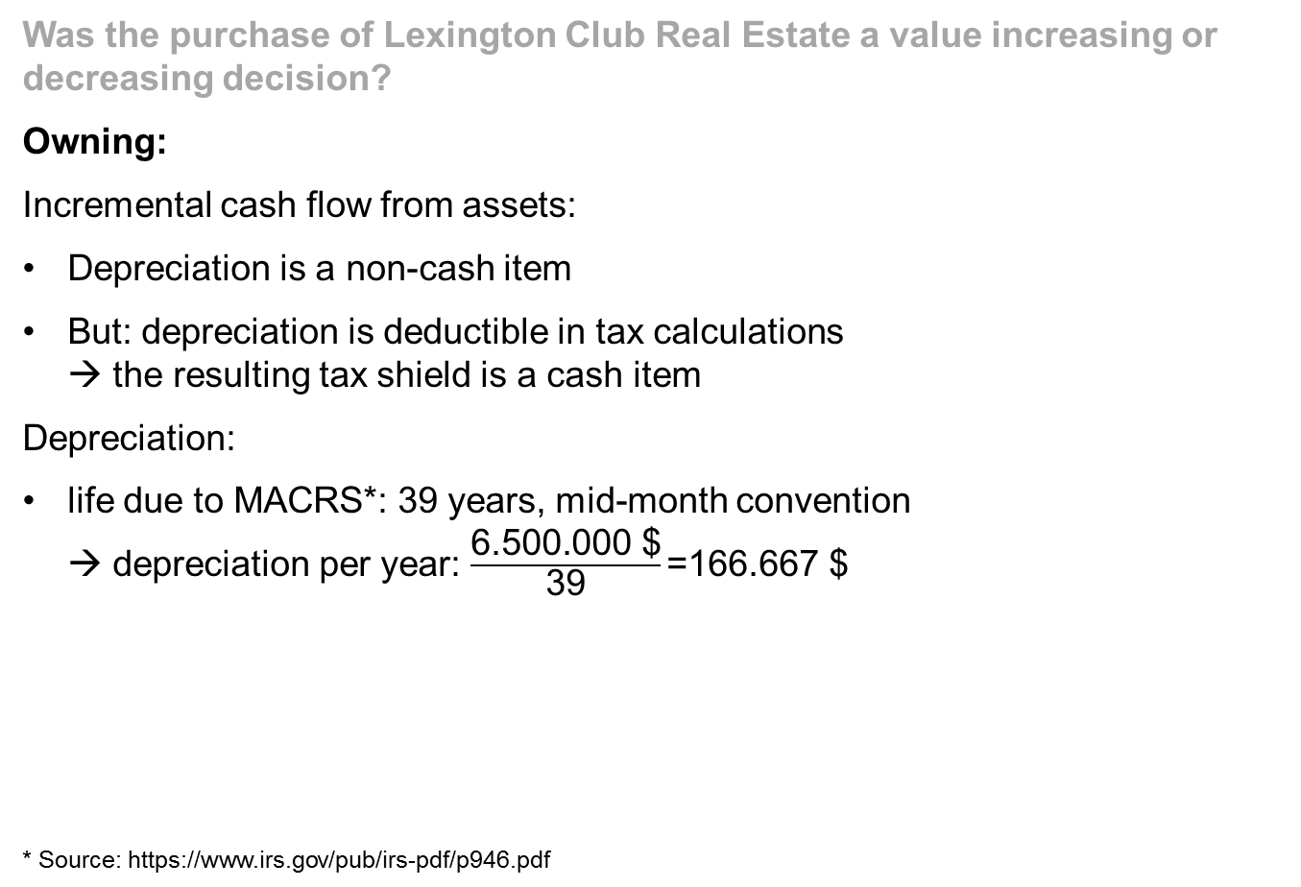
Health Development Corporation: Tasks of the Case Study
Was the purchase of Lexington Club Real Estate a value increasing or decreasing decision?
Owning:
Incremental cash flow from assets:
Depreciation is a non-cash item
But: depreciation is deductible in tax calculations
→ the resulting tax shield is a cash item
Depreciation:
life due to MACRS*: 39 years, mid-month convention
→ depreciation per year: $\frac{\text{6.500.000 \$}}{\text{39}}\text{=}\text{166.667 \$}$
* Source: https://www.irs.gov/pub/irs-pdf/p946.pdf
 |  | year 1 | years 2 - 39 | year 40
depreciation |  | 162.000 | 166.667 | 4.667
taxes (tax shield) =incremental cash flow | 35% | 56.700 | 58.333 | 1.633

Slide 10
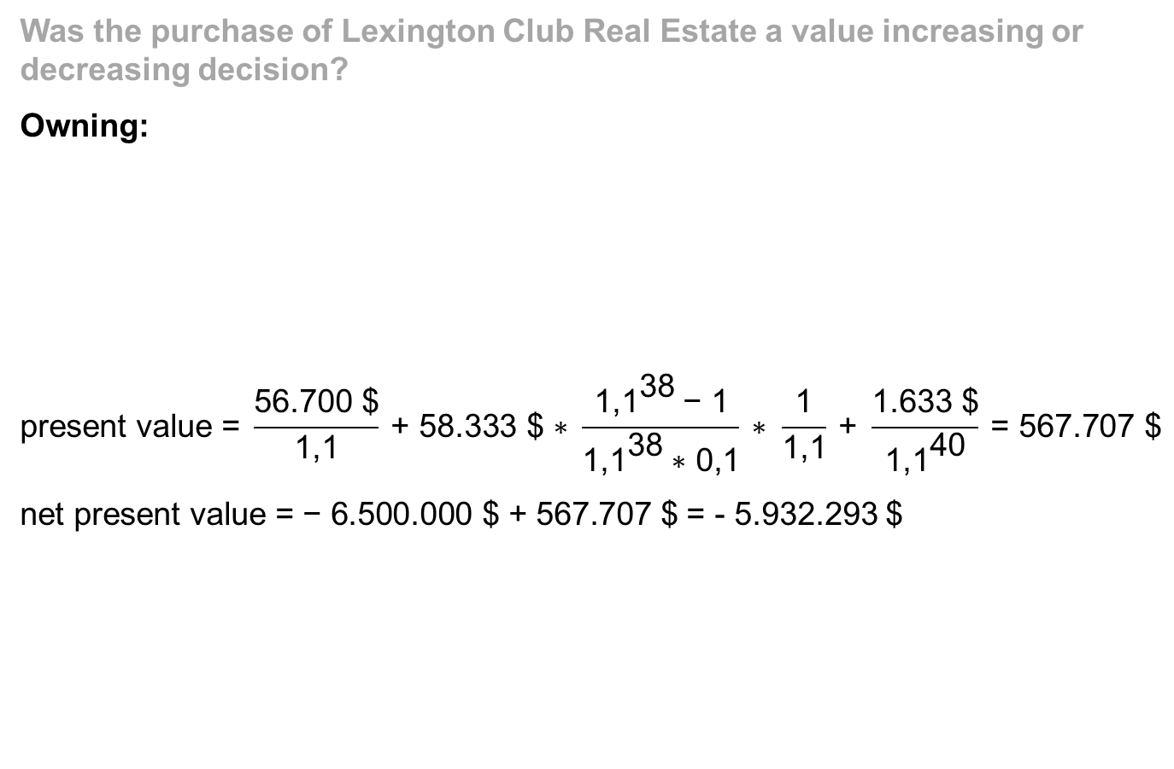
Health Development Corporation: Tasks of the Case Study
Was the purchase of Lexington Club Real Estate a value increasing or decreasing decision?
Owning:
$$\text{present} \text{value}\text{ = }\frac{\text{56.700 \$}}{\text{1,1}} \text{+ 58.333 \$ ∗ }\frac{{\text{1,1}}^{\text{38}} \text{−} \text{1}}{{\text{1,1}}^{\text{38}} \text{∗} \text{0,1}} \text{∗ }\frac{\text{1}}{\text{1,1}} \text{+ }\frac{\text{1.633 \$}}{{\text{1,1}}^{\text{40}}} \text{= 567.707 \$}$$
$\text{net} \text{present} \text{value} \text{=}\text{ − 6.500.000 \$ + }\text{567.707 \$}$ = - 5.932.293 $
 |  | year 1 | years 2 - 39 | year 40
depreciation |  | 162.000 | 166.667 | 4.667
taxes (tax shield) =incremental cash flow | 35% | 56.700 | 58.333 | 1.633

Slide 11
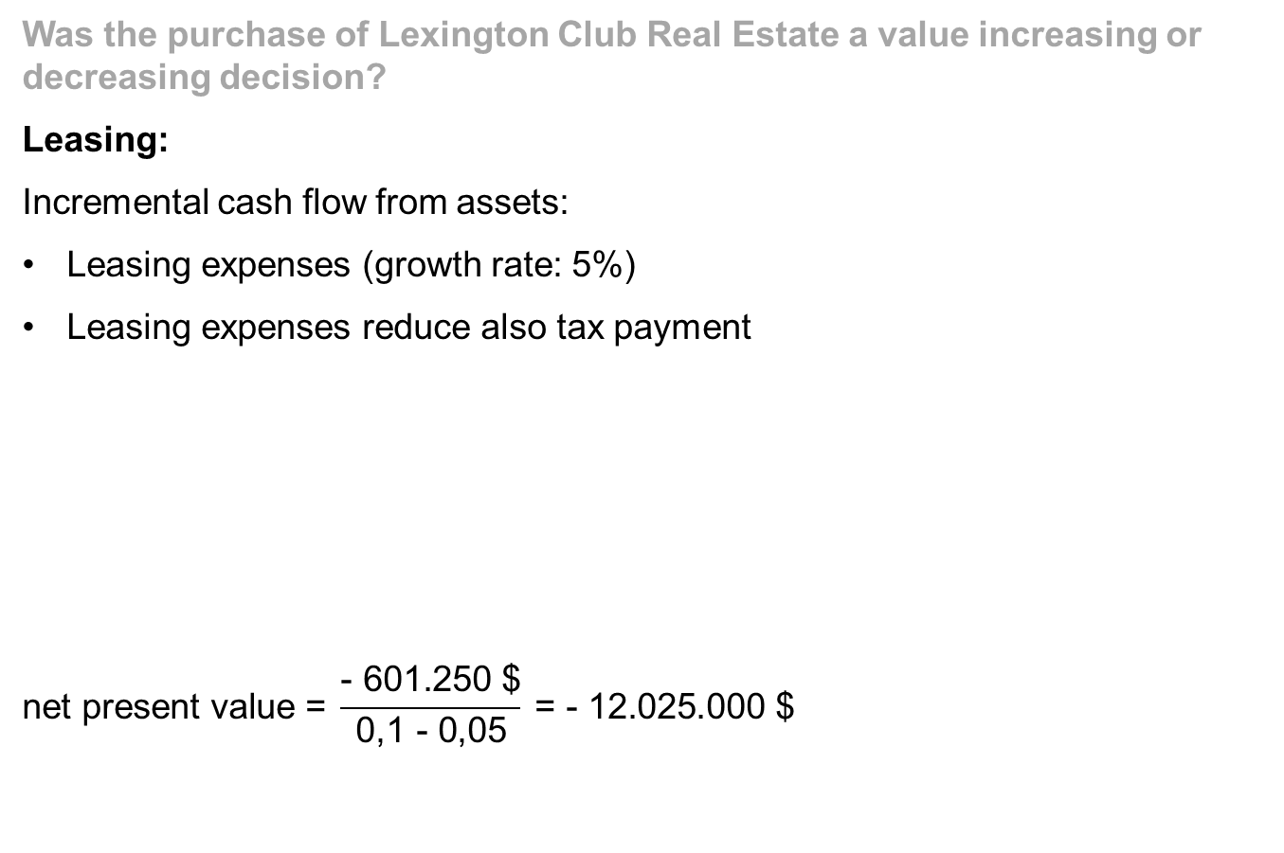
Health Development Corporation: Tasks of the Case Study
Was the purchase of Lexington Club Real Estate a value increasing or decreasing decision?
Leasing:
Incremental cash flow from assets:
Leasing expenses (growth rate: 5%)
Leasing expenses reduce also tax payment
$$\text{net} \text{present} \text{value}\text{ = }\frac{\text{− 601.250 \$}}{\text{0,1 − 0,05}} \text{= − 12.025.000 \$}$$
 |  | year 1
- leasing expenses |  | - 925.000
- taxes | 35% | - 323.750
incremental cash flow |  | - 601.250

Slide 12
Health Development Corporation: Tasks of the Case Study
Was the purchase of Lexington Club Real Estate a value increasing or decreasing decision?
Owning vs. leasing:
Due to the NPV approach, the purchase was a value increasing decision
NPV owning | - 5.932.293
NPV leasing | - 12.025.000
advantage of owning | 6.092.707

Slide 13
Health Development Corporation: Tasks of the Case Study
Why does TSI regard the purchase of Lexington as negative?
TSI uses the multiple approach as the investment criteria
Multiple: 5 times EBITDA → no interest, taxes and depreciation

Slide 14
Health Development Corporation: Tasks of the Case Study
Why does TSI regard the purchase of Lexington as negative?
Owning vs. leasing
 | owning | leasing
revenues | 3.900.000 | 3.900.000
- expenses | - | 925.000
EBITDA | 3.900.000 | 2.975.000
multiple | 5 | 5
project value | 19.500.000 | 14.875.000
- debt | 5.750.000 | -
+ excess cash | - | 750.000
equity value | 13.750.000 | 15.625.000

Slide 15
Health Development Corporation: Tasks of the Case Study
Why does TSI regard the purchase of Lexington as negative?
Owning vs. leasing
equity value owning | 13.750.000
equity value leasing | 15.625.000
disadvantage of owning | - 1.875.000

Slide 16
Health Development Corporation: Tasks of the Case Study
Is the opinion of Health Development Corporation or TSI correct?
Health Development Corporation uses NPV approach:
Advantage of owning: 6.092.707 $
TSI uses multiples approach (5 times EBITDA):
→ Disadvantage of owning: - 1.875.000 $
What is correct?

Slide 17
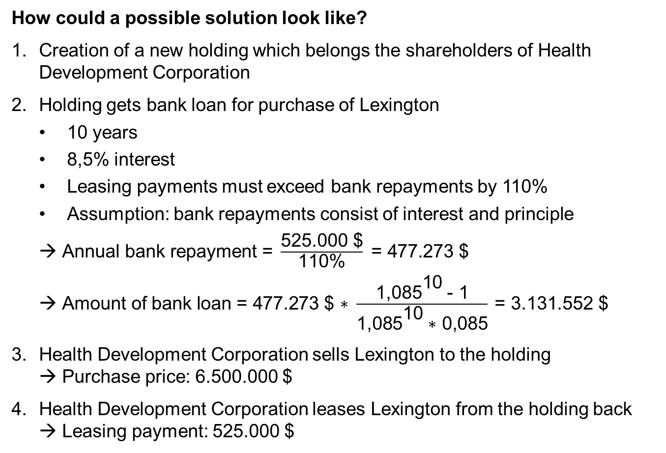
Health Development Corporation: Tasks of the Case Study
How could a possible solution look like?
Creation of a new holding which belongs the shareholders of Health Development Corporation
Holding gets bank loan for purchase of Lexington
  10 years
  8,5% interest
  Leasing payments must exceed bank repayments by 110%
  Assumption: bank repayments consist of interest and principle
  $\text{Annual} \text{bank} \text{repayment}\text{ = }\frac{\text{525.000 \$}}{\text{110\%}}\text{ = 477.273 \$ }$
  $\text{Amount} \text{of} \text{bank} \text{loan}\text{ = 477.273 \$ ∗ }\frac{{\text{1,085}}^{\text{10}} \text{− 1}}{{\text{1,085}}^{\text{10}} \text{∗ 0,085}} \text{= 3.131.552 \$}$
Health Development Corporation sells Lexington to the holding
→ Purchase price: 6.500.000 $
Health Development Corporation leases Lexington from the holding back
→ Leasing payment: 525.000 $

Slide 18
Health Development Corporation: Tasks of the Case Study
How could a possible solution look like?
TSI buys Health Development Corporation
EBITDA before purchase of Lexington and before deal | 3.229.000
+ leasing expenses before purchase of Lexington and before deal | 925.000
- leasing expenses after deal | 525.000
EBITDA after deal | 3.629.000
multiple | 5
value of project after deal | 18.145.000
- loan for purchase of Lexington | 5.750.000
+ money they got for purchase of Lexington to holding | 6.500.000
value of equity after deal | 18.895.000
value of equity with owning before deal | 13.750.000
value of equity with leasing before deal | 15.625.000

Slide 19
Health Development Corporation: Tasks of the Case Study
How could a possible solution look like?
Value for the shareholder
money they paid for purchase of Lexington (holding) | 6.500.000
- loan for purchase of Lexington (holding) | 3.131.552
additional equity the shareholder had to pay in the holding | 3.368.448
advantage for shareholder of owning | 6.092.707
- additional equity the shareholder had to pay in the holding | 3.368.448
remaining advantage for shareholder of owning | 2.724.259

Slide 20
Health Development Corporation
Summary

Slide 21
Health Development Corporation: Summary
Health Development Corporation bought Lexington because they regarded it as a value increasing project (investment criteria: NPV)
advantage of owning: 6.092.707 $
Health Development Corporation should be sold but best bidder (TSI) offers less than expected
reason: TSI regards the purchase of Lexington as a value decreasing project (investment criteria: multiples)
disadvantage of owning: - 1.875.000 $
An alternative structure with a holding can maximize the value:
  Health Development Corporation sells Lexington to holding
  Health Development Corporation leases Lexington back
  TSI buys Health Development Corporation
  Value of equity with multiples approach exceeds the value before the deal
  Value for the shareholder is still 2.724.259 $ more in comparison to the situation before the purchase of Lexington

